Slide 1
OUTDOOR
SCIENCE LESSON
Here is where your presentation begins

Slide 2
CONTENTS OF THIS TEMPLATE
You can delete this slide when you’re done editing the presentation
Fonts | To view this template correctly in PowerPoint, download and install the fonts we used
Used and alternative resources | An assortment of graphic resources that are suitable for use in this presentation
Thanks slide | You must keep it so that proper credits for our design are given
Colors | All the colors used in this presentation
Icons and infographic resources | These can be used in the template, and their size and color can be edited
Editable presentation theme | You can edit the master slides easily. For more info, click here
For more info: SLIDESGO | BLOG | FAQs
You can visit our sister projects: FREEPIK | FLATICON | STORYSET | WEPIK | VIDEVO

Slide 3
TABLE OF CONTENTS
01
OUTDOOR LEARNING
04
FIELDWORK
02
OBJECTIVES
05
CURRICULUM
03
ACTIVITIES
06
CONCLUSIONS
You can describe the topic of the section here
You can describe the topic of the section here
You can describe the topic of the section here
You can describe the topic of the section here
You can describe the topic of the section here
You can describe the topic of the section here

Slide 4
01
OUTDOOR LEARNING
You can enter a subtitle here if you need it

Slide 5
OUTDOOR LEARNING IN THE SCHOOL
Mercury is the closest planet to the Sun and the smallest one in the entire Solar System. This planet's name has nothing to do with the liquid metal, since Mercury was named after the Roman messenger god. Despite being closer to the Sun than Venus, its temperatures aren't as terribly hot as that planet's. Its surface is quite similar to that of Earth's Moon, which means there are a lot of craters and plains.
Speaking of craters, many of them were named after artists or authors who made significant contributions to their respective fields. Mercury takes a little more than 58 days to complete its rotation, so try to imagine how long days must be there! Since the temperatures are so extreme, albeit not as extreme as in Venus, and the solar radiation is so high, Mercury has been deemed to be non-habitable for humans.

Slide 6
LEARNING OUTSIDE THE CLASSROOM
Do you know what helps you make your point clear?
Lists like this one:
They’re simple
You can organize your ideas clearly
You’ll never forget to buy milk!
And the most important thing: the audience won’t miss the point of your presentation

Slide 7
SCIENCE FOR CURIOUS MINDS
ENGAGE
ENCOURAGE
Mercury is the closest planet to the Sun and the smallest one in the Solar System—it’s a bit larger than the Moon
Venus has a beautiful name and is the second planet from the Sun. It’s hot and has a poisonous atmosphere

Slide 8
INCLUDING FIELDWORK
WHY?
WHERE?
HOW?
Mercury is the closest planet to the Sun and the smallest of them all
Venus has a beautiful name and is the second planet from the Sun
Despite being red, Mars is actually a cold place. It’s full of iron oxide dust

Slide 9
OBJECTIVES OF OUTDOOR SCIENCE
OBJECTIVES
OBJECTIVE 1
OBJECTIVE 2
OBJECTIVE 3
Despite being red, Mars is a cold place
Jupiter is the biggest planet of all them
Saturn is a gas giant and has rings
EARTH
VENUS
SUN
MOON
MARS
CERES

Slide 10
TEACHING PHYSICS OUTDOORS
ADVENTURE
REAL-LIFE
Mars is actually an extremely cold place
Venus has extremely high temperatures
INTERACTIONS
ENVIRONMENT
Jupiter is the biggest planet of all them
Saturn is a gas giant and has several rings

Slide 11
OUTDOOR SCIENCE ACTIVITIES
IDENTIFY WILDLIFE
MAKE A GARDEN
BUILD BIRD BOXES
OBSERVE THE SKY
SCIENCE ROCKS
SOIL SAMPLING
A
B
C
Mars is actually a very cold place
Venus has a beautiful name
Neptune is far away from the sun
D
E
F
Yes, Mercury is close to the Sun
Saturn is a gas giant with several rings
Jupiter is a gas giant and is it big

Slide 12
AWESOME WORDS

Slide 13
—SOMEONE FAMOUS
“This is a quote, words full of wisdom that someone important said and can make the reader get inspired.”

Slide 14
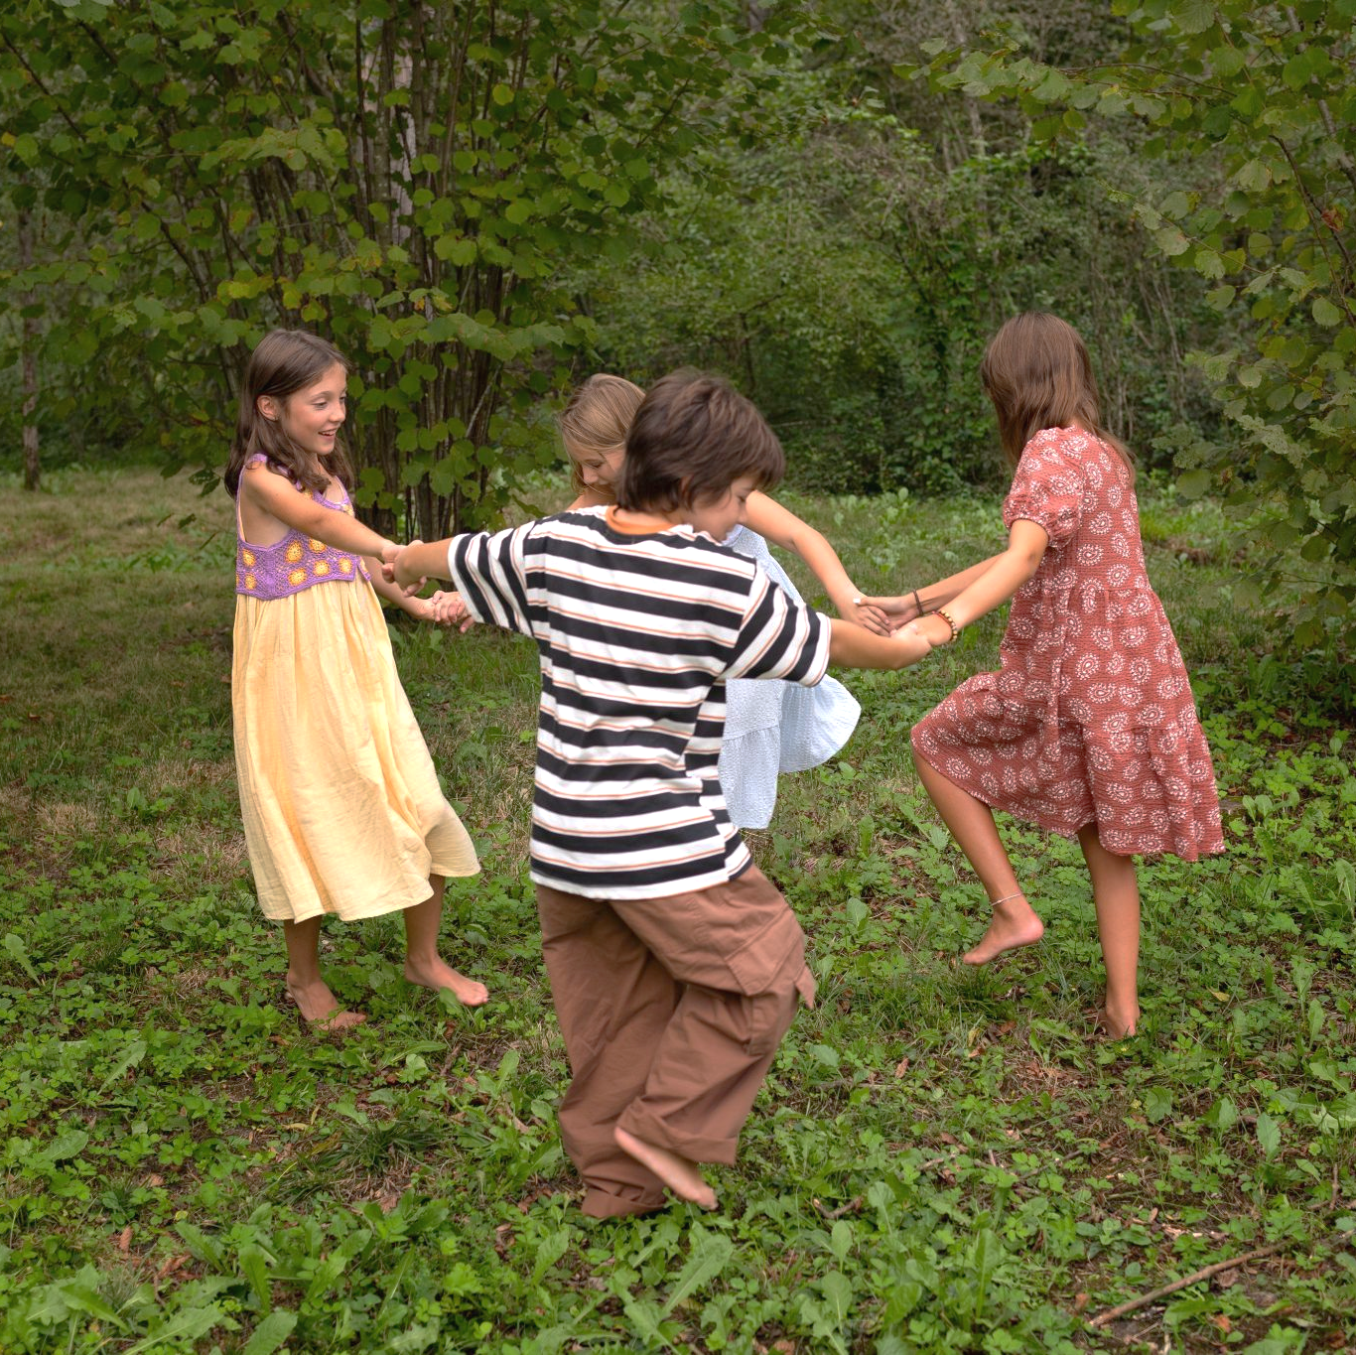
A PICTURE ALWAYS REINFORCES
THE CONCEPT
Images reveal large amounts of data, so remember: use an image instead of a long text. Your audience will appreciate it

Slide 15
MEASUREMENT OF THE EXPERIMENT
4,567
1,000,000
800,000
7,435
Jupiter is a gas giant and the biggest planet in the Solar System
Venus has a beautiful name and is the second planet from the Sun
Saturn is composed mostly of hydrogen and also helium
Despite being red, Mars is actually a cold place full of iron oxide dust

Slide 16
PERCENT COMPOSITION OF SOIL
45%
30%
25%
MINERAL
ORGANIC
WATER
Mercury is the closest planet to the Sun and the smallest of them all
Venus has a beautiful name and is the second planet from the Sun
Despite being red, Mars is a cold place. It’s full of iron oxide dust

Slide 17
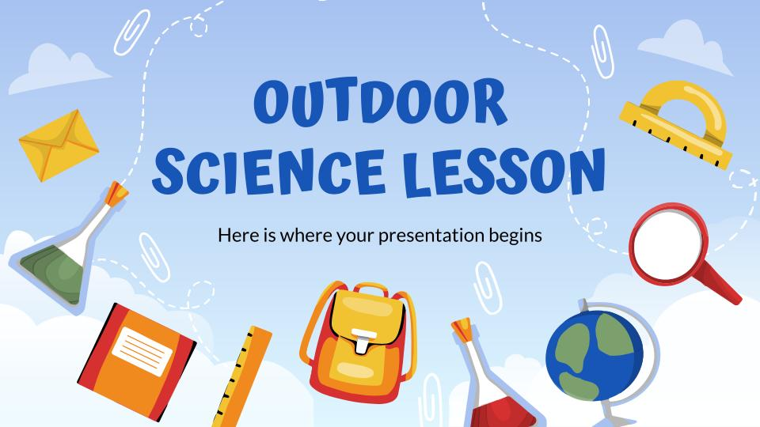
COMPUTER MOCKUP
You can replace the image on the screen with your own work. Just right-click on it and select “Replace image”

Slide 18
TABLET MOCKUP
You can replace the image on the screen with your own work. Just right-click on it and select “Replace image”

Slide 19
MOBILE MOCKUP
You can replace the image on the screen with your own work. Just right-click on it and select “Replace image”

Slide 20
OUTDOOR LESSONS IN A MONTH
 | MON | TUE | WED | THU | FRI
1 Week | Jupiter is a big planet
2 Week |  |  | Saturn has many rings |  | Venus has a nice name
3 Week | Neptune is far away |  |  | Mars is a cold planet
4 Week |  | Mercury is a small planet
Task 1
Task 2
Task 3
Task 4

Slide 21
OUTDOOR LESSON MAP
JUPITER
It is the biggest planet of all them
MARS
Mars is actually a very cold place
NEPTUNE
It is the farthest planet to the sun

Slide 22
04
FIELDWORK
You can enter a subtitle here if you need it

Slide 23
STEP-BY-STEP EXPERIMENT
STEP 1
STEP 2
STEP 3
STEP 4
IDEA
MATERIALS
CUT
CREATE
Mercury is a very small planet
Despite being red, Mars is cold
Earth is the third planet to the Sun
Yes, planet Saturn is a gas giant

Slide 24
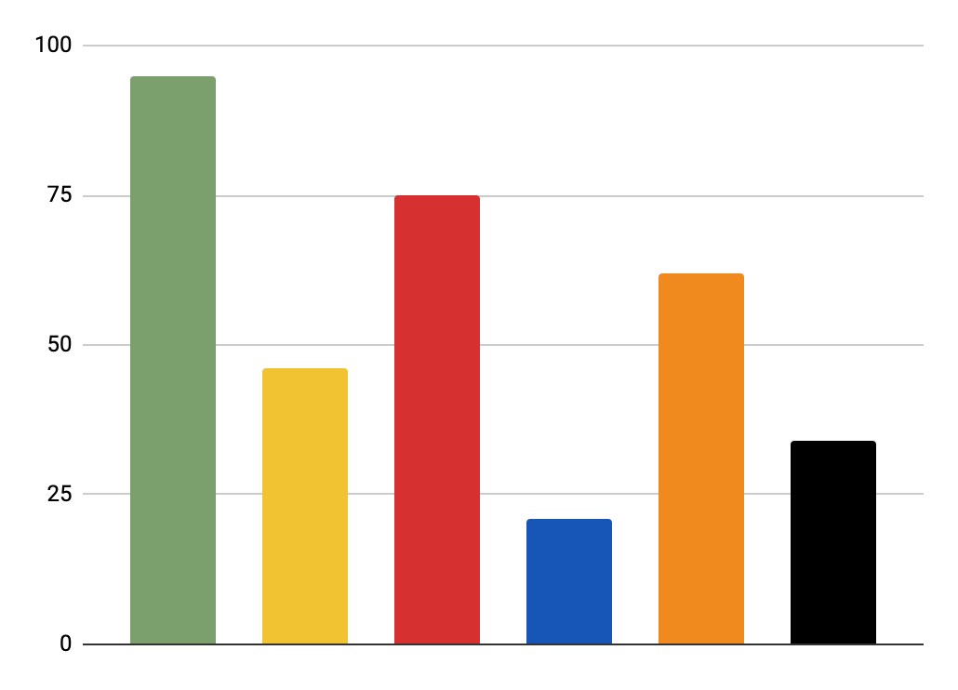
NATURE HUNT
ROCKS
STICKS
Neptune is far away from us
Venus has a nice name
LEAVES
FRUITS
Jupiter is a very big planet
Mars is a very cold planet
FLOWERS
INSECTS
Mercury is close to the sun
Saturn has many rings
95%
46%
75%
21%
62%
34%
Follow the link in the graph to modify its data and then paste the new one here. For more info, click here

Slide 25
CAUSE AND EFFECT EXPERIMENT
CAUSE 1
CAUSE 2
CAUSE 3
Earth is where we live on
Neptune is far away from us
Venus has a nice name
HYPOTHESIS OF THE EXPERIMENT
Mercury is a small planet
Saturn has several rings
Jupiter is a very big planet
EFFECT 1
EFFECT 2
EFFECT 3

Slide 26
COMPONENTS OF THE EXPERIMENT
CHECK LIST
DESCRIPTION |  | DESCRIPTION
 | Mercury is the smallest planet of them all |  | Jupiter is the biggest planet in the Solar System
 | Venus has a beautiful name and is the second from |  | Neptune is the farthest planet from the Sun
 | Despite being red, Mars is actually a cold place |  | The Sun is the star at the center of the Solar System

Slide 27
ROCKS FIELDWORK ASSIGNMENT
TEACHING STRUCTURE
Mercury is the closest planet to the Sun and the smallest one in the Solar System—it’s only a bit larger than our Moon. The planet’s name has nothing to do with the liquid metal
The Sun is the star at the center of the Solar System
Jupiter is the biggest planet in the entire Solar System

Slide 28
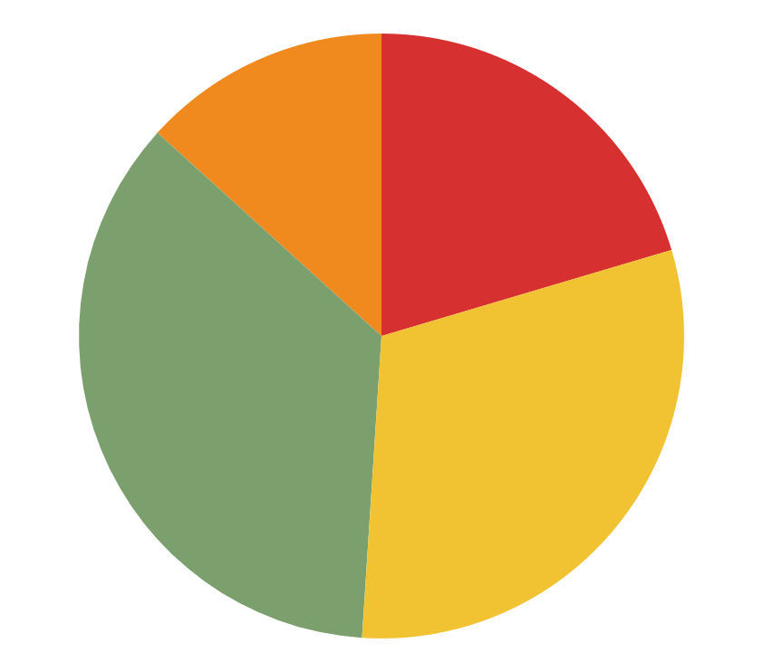
OBSERVATION OF ROCKS ACTIVITY
15%
20%
SMALL
BIG
Mercury is the closest planet from the sun
Jupiter the biggest planet of all them
35%
30%
SMOOTH
POINTY
Venus has a beautiful name, but is very hot
Despite being red, Mars is a cold place
Follow the link in the graph to modify its data and then paste the new one here. For more info, click here

Slide 29
THANKS!
Do you have any questions?
youremail@freepik.com
+00 000 000 000
yourwebsite.com
Please keep this slide for attribution

Slide 30
ICON PACK

Slide 31
ALTERNATIVE RESOURCES
Here’s an assortment of alternative resources whose style fits the one of this template:
Vector hand drawn back to school background

